Slide 1
Travel during the pandemic: A case of Indian hotels
Sundar Raghavan
Undergraduate Student, Department of Instrumentation and Control Engineering
National Institute of Technology Tiruchirappalli
Gajanand M. S.
Faculty of Operations Management and Decision Sciences,
Indian Institute of Management Tiruchirappalli

Slide 2
Introduction
The COVID-19 pandemic has had a large impact on tourism and hospitality.
Change in travellers’ preferences and expectations as pandemic safety takes top priority
Change in day to day operations of hotels mainly due to varying protocols
In order to adapt to the new normal, hotel managers are required to
Switch up internal management practices and
Change marketing strategies to attract customers

Slide 3
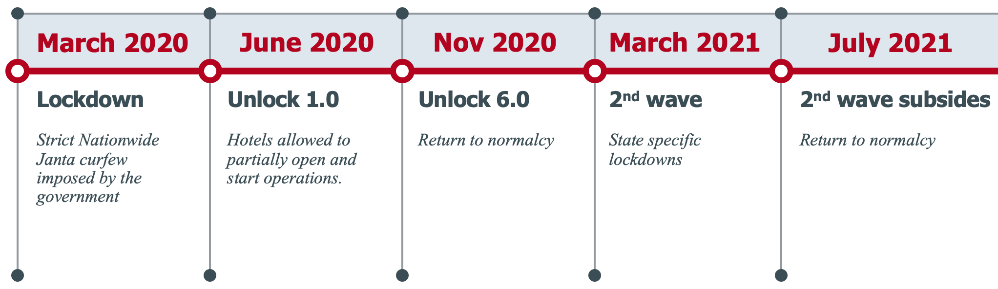
The pandemic in India
The pandemic in India unfolded as given in the figure. Following this, we collect user reviews from March 2020 - July 2021

Slide 4
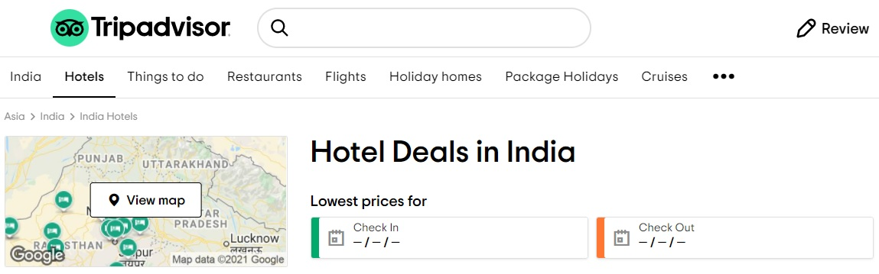
Data Collection
We use the data from TripAdvisor India’s website,
To capture customers’ perspectives about pandemic travel and stay, and
To gauge how well the hotels are keeping up with the times
We scrape hotel data including the list of precautions on the hotel’s TripAdvisor webpage

Slide 5
Data Cleaning
Some data is bound to be missing as we collect data from both high end and low-end hotels all across the country
For user reviews, we:
expanded contractions in the text (didn’t -> did not)
applied lemmatisation along with POS tagging
removed punctuations, stop words, extra spaces
converted all non-ASCII characters to ASCII characters
removed all words that do not exist in the English Dictionary

Slide 6
Topic Modelling
Topic modelling is a technique to apply statistical models for discovering the abstract "topics" that occur in a collection of documents
With the cleaned reviews, we proceed to perform topic modelling using the Latent Dirichlet Allocation (LDA) algorithm
LDA
Introduced by Blei et al. (2003) as a generative probabilistic model of a corpus
Each review is assigned a set of topic probabilities
Each topic is given as a mixture of the most dominant words in that topic
Labelling of these topics is then done manually

Slide 7
LDA Topics
We found 9 unique topics and labelled them as follows:
Food quality and compliance with COVID protocols
Staff service during the COVID pandemic
Concerns and complaints
Safety precautions during the hotel stay
Hospitality and stay experience
Ambience and amenities
Overall experience
Property location
Compliments to staff

Slide 8
Sentiment Analysis
We also analyse the sentiment of the reviews with the VADER (Valence Aware Dictionary for Sentiment Reasoning) framework in the Natural Language Toolkit (NLTK) in python
For each review, VADER returns a:
Neutrality score
Positivity score
Negativity score
Aggregated compound score
All ranging from -1 to 1
We focus only on the compound score as the aim is to get a brief idea of the spread of the polarities across the topics

Slide 9
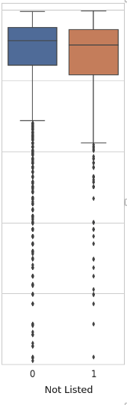
Precautions listed vs Sentiment score
We plot the sentiment scores corresponding to two categories of hotels:
Ones that have listed precautions on TripAdvisor
Ones that have not listed precautions on TripAdvisor
The average, 75%ile and 100%ile scores drop noticeably for hotels that have not listed precautions

Slide 10
Topics vs Precautions Count
It is interesting to observe the spread of topics across hotels taking different levels of precautionary measures
It is common for some hotels to give more priority for COVID safety precautions than other hotels
To gauge this, we introduce a variable that has the count of the precautions that each hotel has listed on their TripAdvisor page
We bin this variable into three buckets: [0,5], (5, 10], (10, 15]

Slide 11
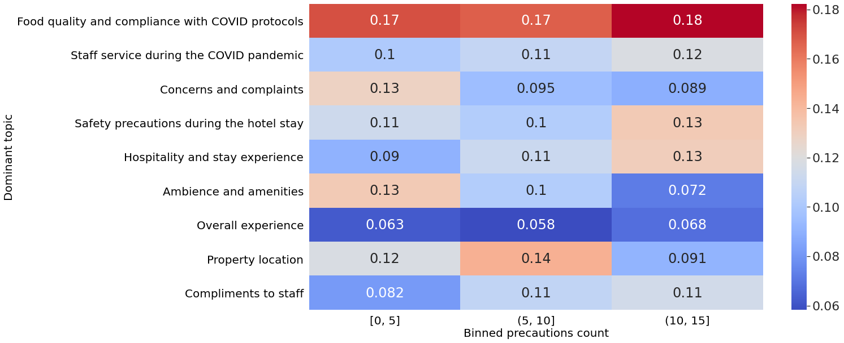
Topics vs Precautions Count - Observations
Customers complain more during the pandemic when they stay in hotels that have listed lesser number of precautions
For the above hotels, the focus shifts to the ambience and the amenities offered by the hotel
There is a proportional decrease in hospitality and compliments to the staff

Slide 12
Managerial Implications
Increase precautions taken and listed on the TripAdvisor page
This will give customers much higher confidence about the safety of their trip (Herrero et al., 2015)
The polarity score of the reviews drops significantly for hotels that have not listed precautions compared to the ones that have
The share of reviews belonging to the “Concerns and Complaints” topic increases sharply for hotels that have not listed precautions
Spotlight (highlight) reviews with positive feedback about precautions
To ensure a more positive electronic word of mouth (e-WOM) effect and
To give a positive impression of the hotel on prospective guests

Slide 13
Implications for Research
Any User Generated Content (UGC) based study in the context of tourism in the coming years must strongly consider the role of the pandemic including:
Analysing hotel precautions
Analysing reviews with COVID specific keywords and their e-WOM effect
With the revival of international tourism looking gloomy, we recommend researchers to prioritise content generated by domestic tourists as:
Domestic tourism will be the main driver for tourism recovery around the world
International tourism may not return to pre-pandemic levels till 2023 in the Asia-Pacific region

Slide 14
Key References
Herrero, Á., San Martín, H., & Hernández, J. M. (2015). How online search behavior is influenced by user-generated content on review websites and hotel interactive websites. International Journal of Contemporary Hospitality Management.
Taecharungroj, V., & Mathayomchan, B. (2019). Analysing TripAdvisor reviews of tourist attractions in Phuket, Thailand. Tourism Management, 75, 550-568.
Kirilenko, A. P., Stepchenkova, S. O., & Dai, X. (2021). Automated topic modeling of tourist reviews: does the Anna Karenina principle apply?. Tourism Management, 83, 104241
Guo, Y., Barnes, S. J., & Jia, Q. (2017). Mining meaning from online ratings and reviews: Tourist satisfaction analysis using latent dirichlet allocation. Tourism Management, 59, 467-483.

Slide 15
Thank You

